Slide 1
Welcome to our Infant Support evening.

Slide 2
Reading

Slide 3
Learning letter sounds
We do not learn in alphabetical order
Letters are learnt using their phonetic sound, not name
We must get pronunciation of letter sounds correct so words can be deciphered
Each phoneme (sound) is taught alongside an action and a song to make it more memorable.

Slide 4
Letter Sounds
‘s’ as in sun (not ser) | ‘a’ as in ant | ‘t’ as in tap | ‘i’ as in ink | ‘p’ as in pig
‘n’ as in nut (not ner) | ‘m’ as in man (not mer) | ‘d’ as in dog | ‘g’ as in goat | ‘o’ as in off
Notes:
Beautiful reading diaries with sounds in.

Slide 5
Segmenting and Blending
The children can start segmenting and blending once confident with many letter sounds.
They segment – break word into separate sounds:
top t o p.
They blend – repeat sounds over and over quicker each time until saying word correctly:
t o p t o p top
Words which are not sounded as read need to be learnt as a whole word, e.g. no, come.

Slide 6
Digraphs
Digraphs are two letters that make one unit of sound e.g. ch. They are learnt once confident with the letter sounds.
When segmenting and blending, they must be read as a whole sound, not individual letter sounds:
sh not s h

Slide 7
Digraphs
‘ai’ as in pain sail | ‘oa’ as in boat coast | ‘ie’ as in pie fried
‘ee’ as in seed tree | ‘or’ as in born short | ‘ng’ as in strong swimming

Slide 8
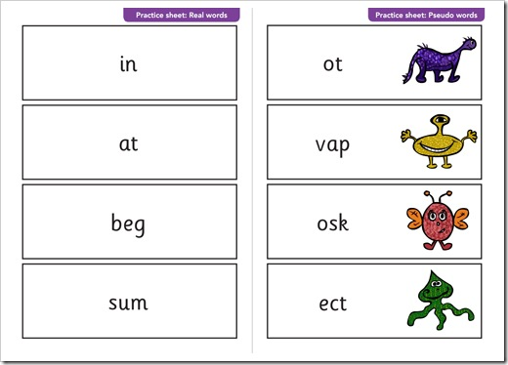
Statutory Phonics Screening Check

Slide 9
English, Grammar, Punctuation & Spelling
The new English grammar, punctuation and spelling test (informally known as the SPAG test) was introduced in May 2013 as part of the KS2 SATs programme for Year 6 pupils, replacing the previous English writing test.
The Government wants all children to leave primary school with a sound grasp of
essential English skills. The test will put an additional focus on writing skills.
For children taking KS2 SATs from May 2016, the SPAG test has been updated (in line with the new primary curriculum) and will be more challenging.

Slide 10
What does the EGPS test examine?
The key stage 1 English grammar, punctuation and spelling test is designed to assess grammar, punctuation, language strategies and spelling. Language strategies refer to those parts of the content domain that relate to words and word building, such as the use of prefixes and suffixes.

Slide 11
Example questions:
Draw lines to match each sentence with its correct type.
The first one has been done for you.
How terrible!
Question
Don’t drop the eggs.
Exclamation
I’ve broken an egg.
Command
How will I get another for our breakfast?
Statement

Slide 12
Look at what Mary and John are saying. The words Don’t, I’ve and I’ll all have an apostrophe ( ’ ). In the table, write in full each of the words with an apostrophe. The first one has been done for you.
Word with an apostrophe | Words in full
Don’t | Do not
I’ve
I’ll

Slide 13
Tick two sentences that are correct.
The children is waiting for the rain to stop.
Holly is waiting for another turn on the swings.
I am waiting until lunchtime.
He are waiting for the bus every day

Slide 14
Key words
Key words (high frequency words) which children need to learn;
Many have irregular spellings;
There are 2 sets of key words: a reception list and a key stage one list;
First, recognising and saying word;
Then they can move onto writing the word.

Slide 15
Reception list
is | it | in | at | a | an | and | as | to | the
no | go | I | mum | dad | if | of | off | on | can
am | had | get | big | him | back | not | got | up | his
but | put | into | he | she | we | me | be | was | my
this | that | they | you | her | all | will | are | then | them
with | see | for | now | down | look | too | said | so | have
like | some | come | were | there | little | one | do | when | out
what | went | it’s | from | children | just | help | us | has | here
did | next | take | time | away | live | call | old | two | because
once | made | came | last | saw | make | We will begin by recognising each word by sight, as we build up our reading skills. From there, we progress onto being able to spell each word in our writing and continue this into year one.

Slide 16
Key Stage One list
about | after | again
an | another | as
back | ball | be
because | bed | been
boy | brother | but
by | call | came
can’t | could | did
do | don’t | dig
door | down | first
from | girl | good
got | had | half
has | have | help
her | here | him
his | home | house
how | if | jump
just | last | laugh
little | live | love
made | make | man
many | may | more
much | must | name
new | next | night
not | now | off
old | one | or
our | out | over
people | push | pull
put | ran | saw
school | seen | should
sister | so | some
take | than | that
their | them | then
there | these | three
time | too | took
tree | your | us
very | want | water
way | were | what
when | where | who
will | with | would
Also:
Days of the week;
Months of the year;
Colours;
Numbers to twenty.

Slide 17
Comprehension
There is more to reading than just decoding words;
Many children read without real understanding;
In order to enjoy books, we need to understand them.
Notes:
Pause to ask questions:
Why did the character say / do this?
Why is this part funny?
What do you think will happen next?
How do you think this character is feeling?
What have we learnt from this chapter?
At the end of a book, ask for an opinion with reasons.
Encourage children to find out the meanings of unfamiliar words either by asking or, later on, using a dictionary.

Slide 18
Experiencing Texts
From school:
Active Reading book;
Scheme book
Library book
Elsewhere:
Home;
Library;
Magazines;
Signs / adverts.
Look out for the top tips in the reading diary and the beginning of books.
Notes:
Sharing texts
Read to the child
Adult reads some, child reads the simple words
Child reads
Reading Activities
Books
* read a few pages, sounding out words
* discuss book
* find particular words or sounds out of order
* get your child to ask you questions
Sound / Word cards
* build words to say and write
* child suggests words with particular sounds in
* sentence construction
* match card to word / sound in a book

