Slide 1
Assessment in Year 2
An Information Evening for Parents
Notes:
We have put together this information evening in response to lots of commonly asked questions from last year.
If there are additional questions which you have, please feel free to ask them as we go along.

Slide 2
What we Assess
English Reading is assessed using two comprehension tests which have slightly different formats. We also take into account conversations from when we listen to your child read their reading book and during ‘Active Reading’ group sessions.
English, Grammar, Punctuation and Spelling is assessed using the National Curriculum Test.
English Writing is assessed using a range of children’s independent work produced during the Spring and Summer term.
Maths is assessed against the National Curriculum Objectives using examples from Maths tests throughout the year and pupils’ work in their maths books.
Science is assessed using conversations and work from Science lessons.
Phonics if your child did not pass this test in Year 1 (please see slide on phonics screening check below).

Slide 3
The National Curriculum Tests
Will take place during May.
Conducted in small groups in the classroom.
Some children will work with adults in a 1:1 environment to help them to achieve their best.

Slide 4
Year 2 SATs All you need to know
https://youtu.be/dVlrdqh_J6Y

Slide 8
PROGRESS
Each year, your child’s progress will be carefully tracked.
Parents are given information about their child’s progress through Workshares, end of term target reports in December and March, parents / teacher consultations in October and March, One Plan meetings for SEND pupils and a final end of year report in July.
Expected progress:
Developing in Y1 to developing in Y2
Secure in Y1 to secure in Y2
More than expected progress:
Developing in Y1 to secure in Y2
Secure in Y1 to greater depth in Y2

Slide 9
Questions?
Thank you for coming & for all of your support at home!

Slide 10
Additional information
Please see following slides for your reference and additional information.
This presentation can be found on the school website:
http://www.huttonallsaints.co.uk/

Slide 11
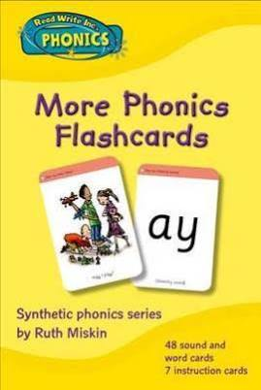
The Phonics Screening Check
Phonics Screening Check in June 2018 for all year 1 pupils and year 2 pupils, who did not pass when in year 1.
Blending and segmenting unknown words
Notes:
How to help at home: phonics homework & READ!

Slide 12
How to help with Reading
Listen to your child read or give them time to read and then talk to them about their book.
Ask your children what words mean: “What word could you use instead?”
Ask your children “Who, What Where, WHY” questions.
Encourage your children to show you where they have got their answer from.
Use ‘reading vocabulary’ – e.g. setting, character, caption, event…
Encourage your child to infer meaning: “Why is Henry straight faced?”

Slide 13
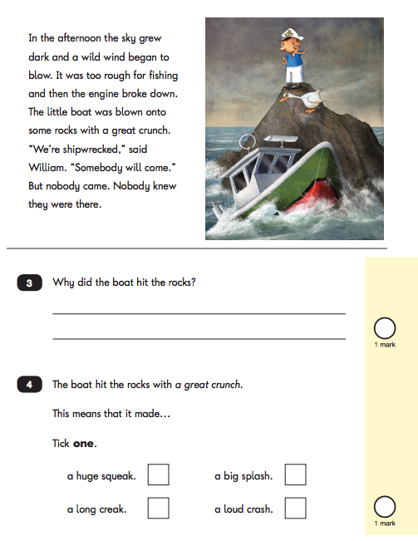
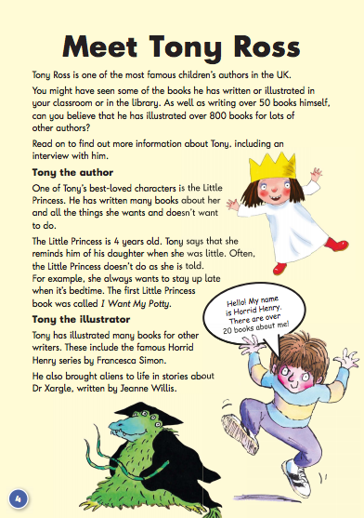
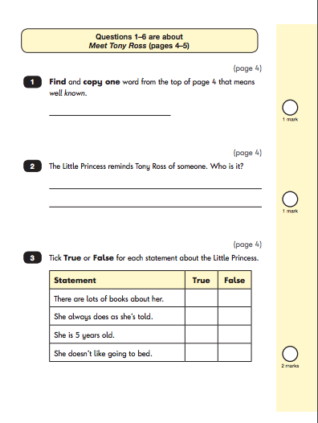
Reading
Word Reading & Comprehension
Paper 1 - includes the texts and questions combined.
Paper 2- consists of a reading booklet and a separate reading booklet.
Both of these tests can be stopped if a child is finding it too difficult, children can also be given breaks during the test.
Used as an example against the National Curriculum Objectives
Paper 1
Paper 2
Notes:
There are 2 reading papers.
Paper 1 includes the texts and questions combined and Paper 2 contains more challenging texts with the questions in a separate booklet.
Each paper has a selection of texts which are designed to increase in difficulty. There is a mixture of text genres. Paper 1 consists of a combined reading prompt and answer booklet. The paper includes a list of useful words and some practice questions for teachers to use to introduce the contexts and question types to pupils. The test takes approximately 30 minutes to complete, but is not strictly timed.
Paper 2 consists of an answer booklet and a separate reading booklet. There are no practice questions on this paper. Teachers can use their discretion to stop the test early if a pupil is struggling. The test takes approximately 40 minutes to complete, but is not strictly timed.

Slide 14
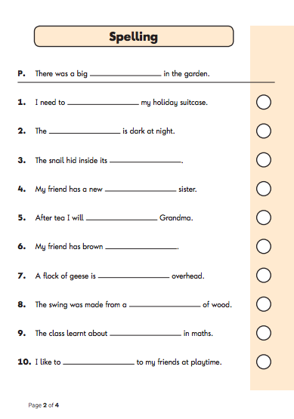
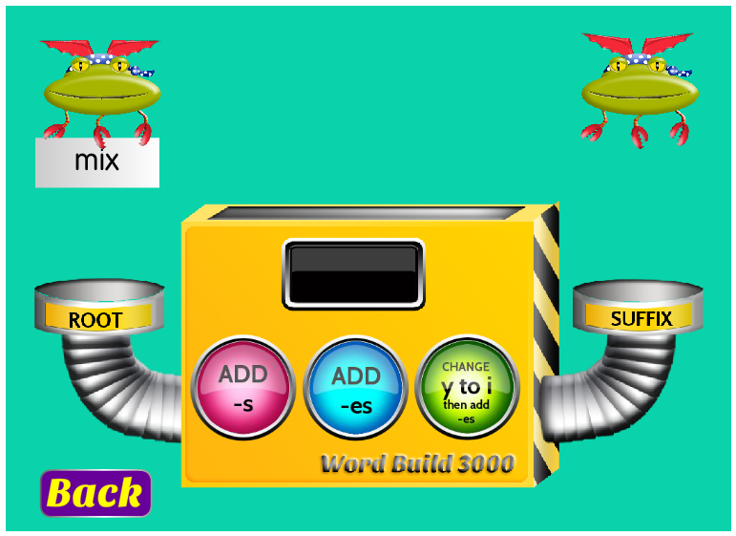
English, Grammar, Punctuation & Spelling (EGPS)
Spelling
Paper A is a Spelling test which tests.
Key words & phonic patterns and spelling rules learnt weekly in class with examples and practiced at home.
Applied in work
Notes:
Spellings are tested in paper A. The format of this paper is that the spellings are read out, then read in a sentence then read again. Children are given plenty of time to spell the word and think about the spelling rule to apply. We have learnt spelling rules each week in class, practiced the rules at home and tested them at the end of the week. There are also a few ‘common exception’ words. To help your child prepare for this part of the test, they can use their spelling folders to revise the words which they found difficult. Don’t slog away - use coloured pens, writing on the bath wall, magnets. Using joint handwriting will help children to get a ‘feel’ for the words. We have used strategies in class such as looking at the word shapes, sound speaking, and finding words within words to help us to recognise the correct spelling rule.

Slide 15
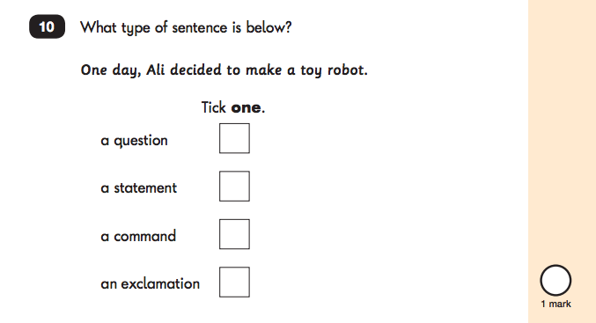
English, Grammar, Punctuation & Spelling (EGPS)
Grammar & Punctuation
Paper B tests children’s spoken English, grammar & punctuation.
It consists of multiple choice questions, circling answers & questions with written answers.

Slide 16
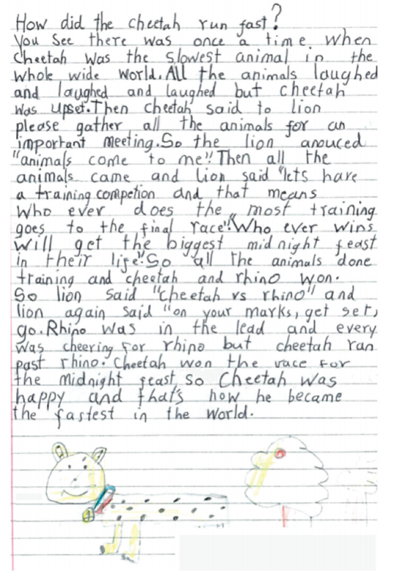
Writing
Writing paragraphs of text – stories, information texts, instructions
Using ? ! . ,
Applying the spelling rules learnt each week to their writing
Using noun phrases
Letters which are correctly formed, the right size and which sit on the line
Writing Example
Notes:
FIND A SECURE PIECE OF WRITING AS AN EXAMPLE

Slide 17
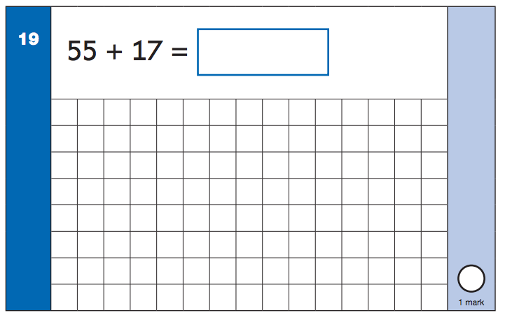
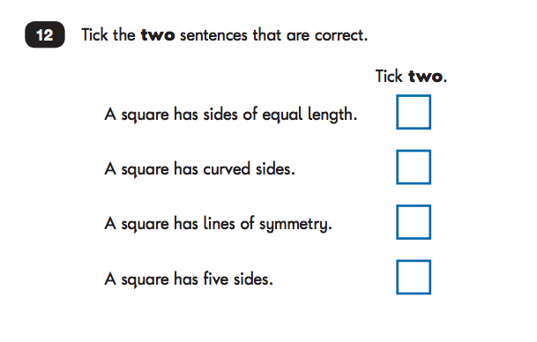
Maths Test
Paper 1
arithmetic assesses pupils’ fluency in the fundamentals of mathematics
place value
calculations
Fractions
Paper 2
solve problems and reason mathematically
Paper 1
Paper 2
Notes:
There are 2 mathematics papers:
Paper 1: arithmetic
Paper 2: reasoning
Paper 1: arithmetic assesses pupils’ fluency in the fundamentals of mathematics, including place value, calculations and fractions. Some questions have grids in the answer or working out spaces. Grids are provided with questions where pupils may benefit from using more formal methods for calculations. The arithmetic test consists of a single test paper and takes approximately 20 minutes to complete, but is not strictly timed. The paper includes a practice question.
Paper 2: reasoning assesses pupils’ mathematical fluency by demonstrating their ability to solve problems and reason mathematically. The reasoning test consists of a single test paper and will take approximately 35 minutes to complete, but it is not strictly timed. The paper includes a practice question and 5 aural questions. After the aural questions, the time for the remainder of the paper should be around 30 minutes.

Slide 18
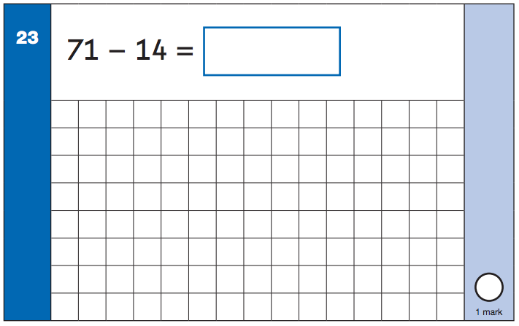
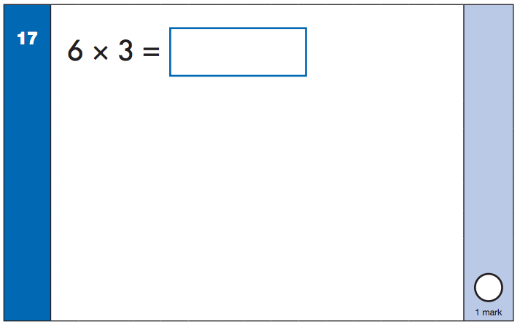
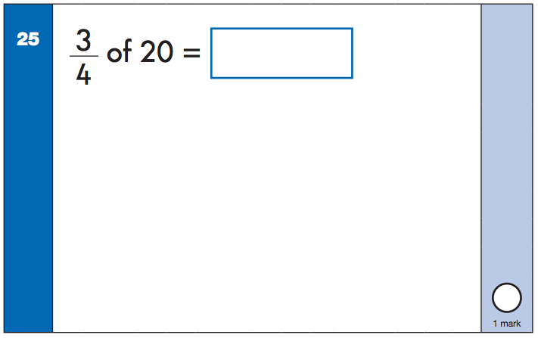
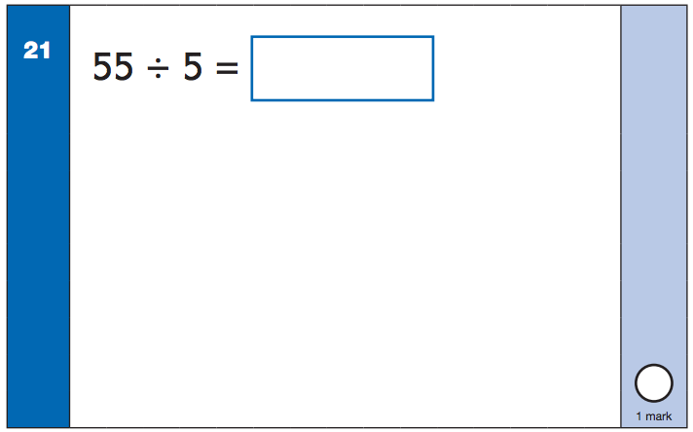
Maths Examples
Notes:
Subtraction using a numicon / a number line
Multiplication counting in 3s - highlight that children should be able to count in 10s, 2s, 5s & 3s
Division using groups - 5 groups with 10 in each one then 1 in each group > 5 groups of 11 = 55
¾ of a number - find ¼ and then add up the three quarters
Place Value
Addition of two digit numbers
Subtraction of two digit numbers
Multiplication & division facts for the 2, 3, 5 & 10 times tables
Recognise, find, name and write 1/3, ¼, 2/4, ¾ of a length, shape of quantity.
Naming and describing properties of 2D & 3D shapes including vertices, faces, edges

Slide 19
Reading with an adult. The different styles of questions.
The following slides show the different styles of questions you may like to try out when you read with your child.

Slide 20
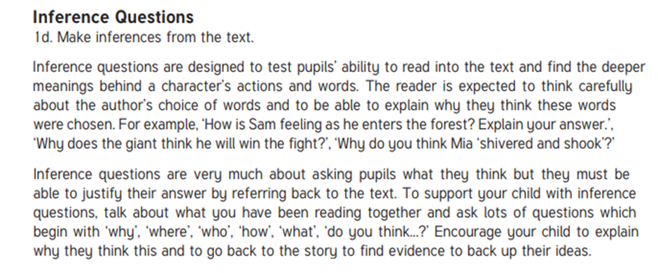
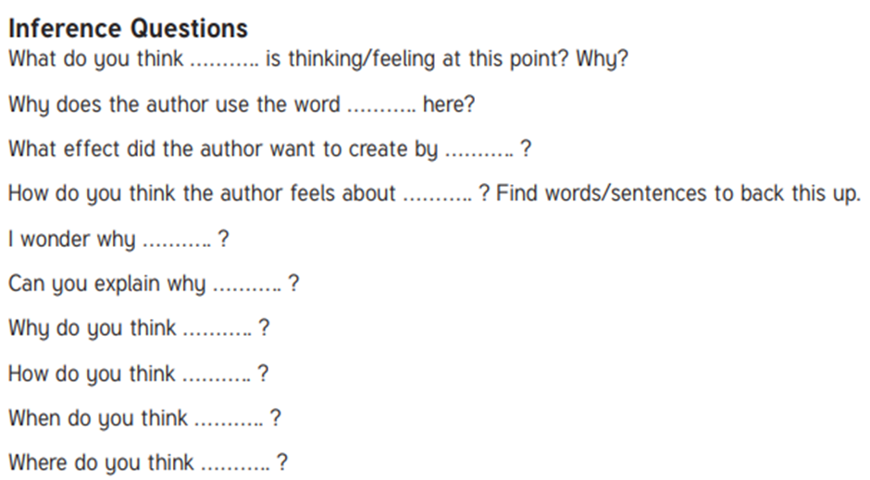
Inference
Questions

Slide 21
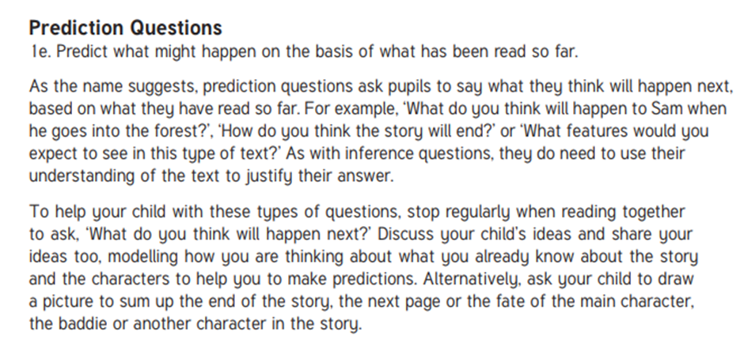
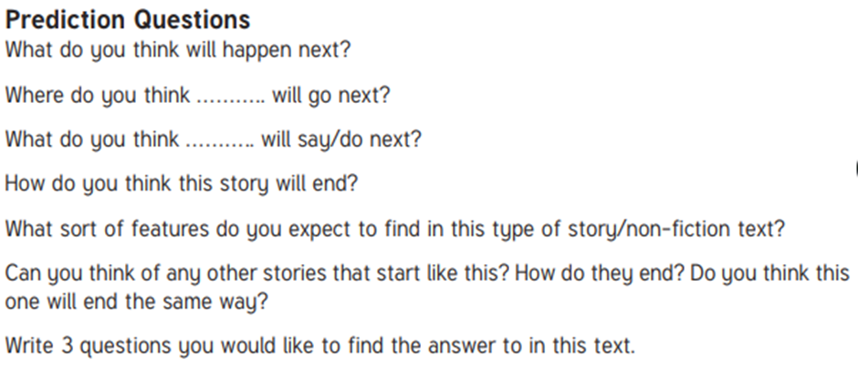
Prediction
Questions

Slide 22
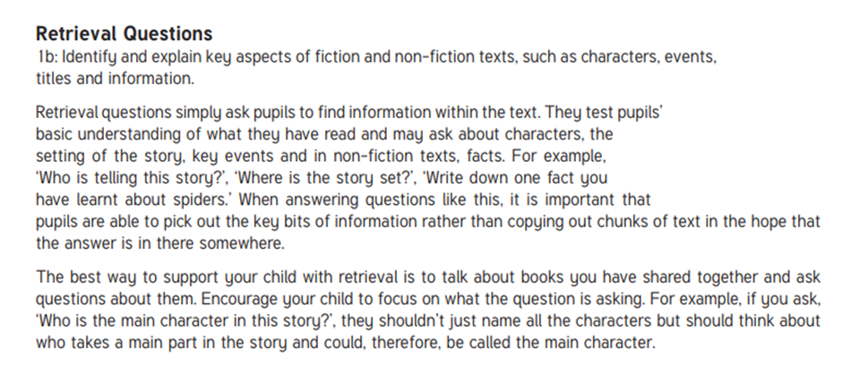
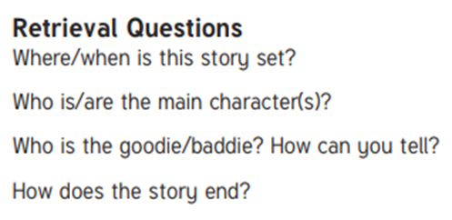
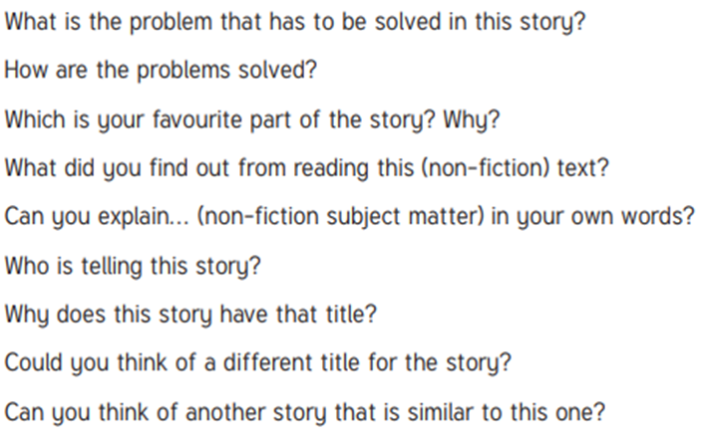
Retrieval
Questions

Slide 23
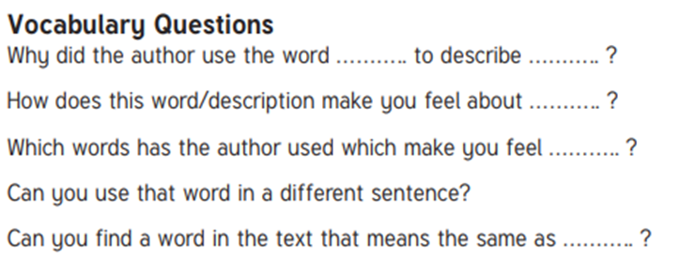
Vocabulary
Questions

Slide 24
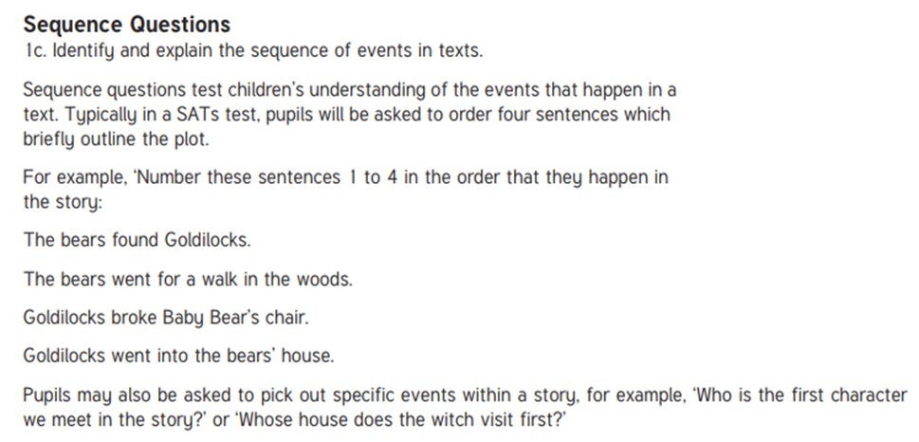
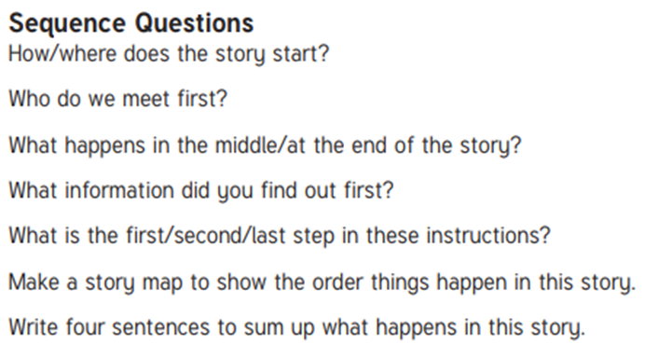
Sequence
Questions

